Slide 1
CPQ / CRM Kick-Off

Slide 2
Introduction
Solution Scope
Delivery Approach
Team Roles and Responsibilities
Critical Success Factors and Communication
Next Steps

Slide 3
Introduction
CPQ (Configure Price Quote)
TO MASTER AND STRUCTURE ALL PRODUCT LIFE IN A SAME TOOL
Request for Quotation
Developement phase
Mass production
After Sales
CPQ (Configure Price Quote)
TO MONITOR SALES ACTIVITY
& DEVELOP SALES ANALYSIS
Efficient reporting/dashboard
Activity tracking (tooling, dvpt cost…)
CRM (Customer Relation Management)
UNIQUE CUSTOMER DATA BASIS
For customer relationship
Project management
Uniform process for all Customers
- Automatic Sales performance extract
Formal margin follow up
Link and follow up from TMA to order
Lead to efficient reporting
(MSAP / MZK /BUDGET….
Information is centralised shared and capitalized
Up to date tool to make projection and simulation
Time saving as Administrative task automatized,
Added value in structuration -> development of Sales Planning
Daily relationship improved with Customers
Reactivity reinforced

Slide 4
Companies involved
In Mind Cloud
Software Solution Provider
Standard & Customization
Custom Software Extension
Document Requirements
Itelligence
Project Management
Workshop Management
SAP Expertise
Intermediate between In Mind and JTEKT

Slide 5
Introduction
Solution Scope
Delivery Approach
Team Roles and Responsibilities
Critical Success Factors and Communication
Next Steps

Slide 6
Scope: Process View
Customer Request
Sales Support Application
Others Dept.
Action Follow Up
Others Dept. Data Collection
Sales TMA/ Offer Preparation
Sales Top Managament Agreement
Sales Offer Setting
Customer Offer Report
Order
Sales Administration

Slide 7
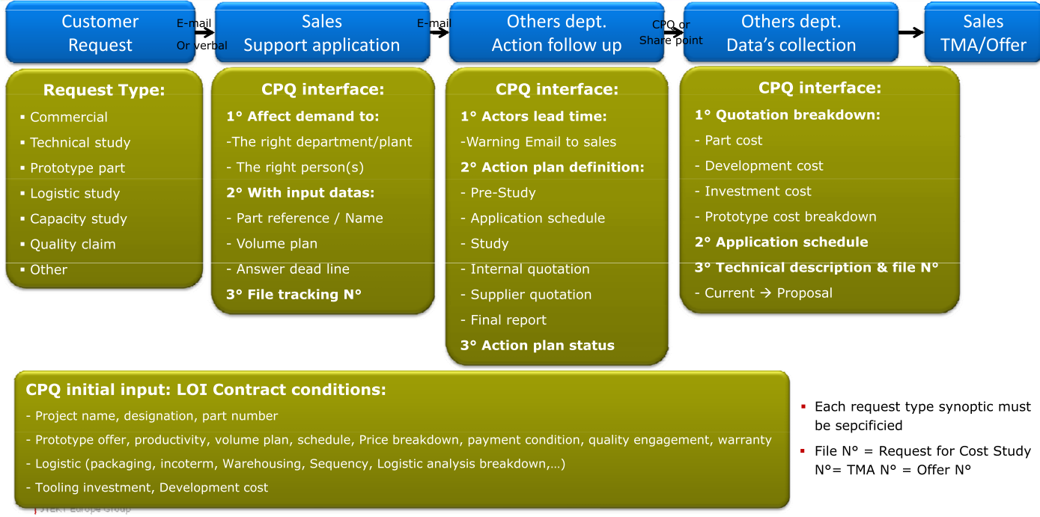
Scope (1)

Slide 8
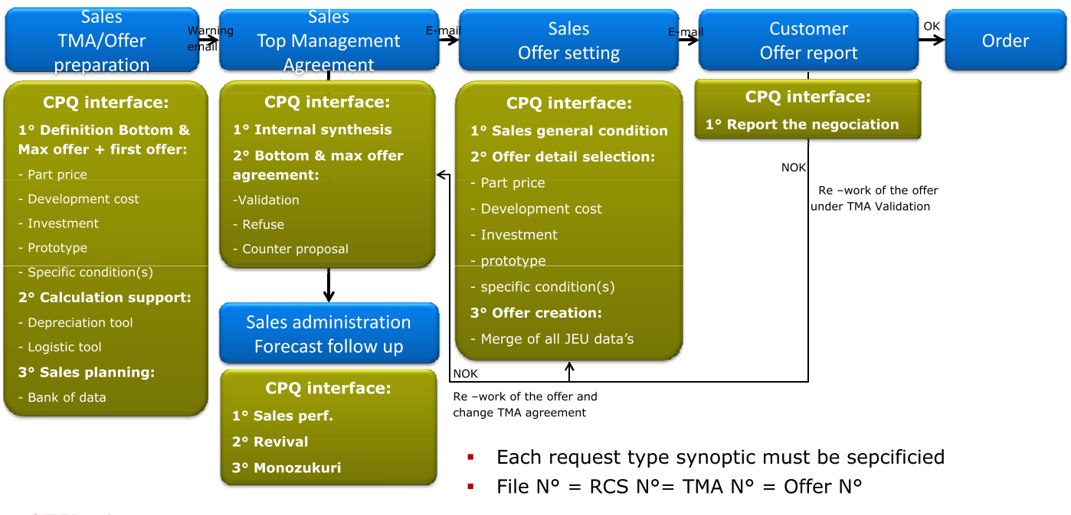
Scope (2)
PHASE 2

Slide 9
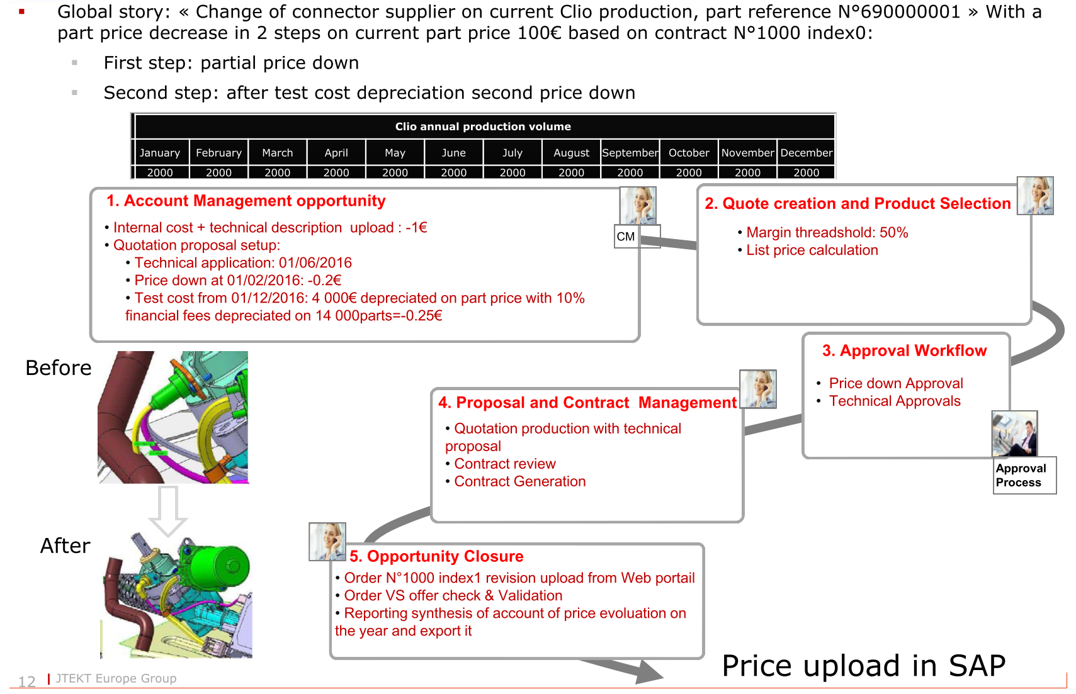
Example

Slide 10
Introduction
Solution Scope
Delivery Approach
Team Roles and Responsibilities
Critical Success Factors and Communication
Next Steps

Slide 11

Phase 1 : CRM & CPQ Sales process
Tasks for Implementation Project |  | May 2017 |  |  |  |  | June 2017 |  |  |  | July 2017 |  |  |  | August 2017 |  |  |  |  | September 2017 |  |  |  |  | October 2017
# | Task
1 | Project Kick-off (Phase 1)
2 | Blue Printing workshop (onsite) & preparation
3 | Product model creation for Price management
4 | Initial System Setup and ERP connection
5 | Providing Initial System with basic customizing
6 | Additional Development and Implementation
7 | System customization (creation of user, roles, etc.)
8 | QA System Access
9 | End User Training,
10 | Test and stabilization
11 | Providing Prod.System & Go-Live
12 | After-Go-Live-support, prep. Phase 2 (following 4 weeks)
25
5
9
29/5
12/6

Slide 12
Phase 2 : CPQ Sales Administration
Tasks for Implementation Project |  | October 2017 |  |  |  |  | November 2017 |  |  |  | December 2017 |  |  |  | January 2018 |  |  |  |  | February 2018 |  |  |  |  | March 2017
# | Task
1 | After Go-Live Phase 1
2 | Project Kick-off (Phase 2)
3 | Blue Printing workshop (onsite) & preparation
4 | Model creation for Sales Administration
5 | Additional Development and Implementation
6 | Create Reports (Excel, PDF, inside the system)
7 | Update QA System
8 | End User Training
9 | Test and stabilization
10 | Providing Prod.System & Go-Live
11 | After Go-Live Phase 2

Slide 13







Personas and Tasks
Project Management
Corporate IT Personas
Business Personas
Sales Process Owners
Sales Key Users
Other Dept. Key User
IT Infrastructure
Installation & administration of SAP HANA Cloud Connector
Global view on process, align requirements
SAP Basis Administration
Creation of technical SAP user, creation of table views in SAP, modification of BAPIs if required
Subject Matter Experts, Requirements, Test,
SAP Application Expert
Maintenance of master data e.g., prices and pricing procedures, if required testing of configurable product models
Subject Matter Experts, Requirements, Test,

Slide 14
Introduction
Solution Scope
Delivery Approach
Team Roles and Responsibilities
Critical Success Factors and Communication
Next Steps

Slide 15
Steering Commitee
Project Team
JTEKT
V. Clapeau
PO. Vittet
N. Plataret
C. Dalix
X. Gerber
In Mind
F. Brauer
D. Bhardwaj
Itelligence
G. Duprez
Project-Mgmt & Sales Process Owners
JTEKT
C. Dalix
C. Cuppi
In Mind
F. Brauer
itelligence
G. Duprez
Sales Department
G. Seror (RNPO)
P. Gautier (BMW)
C. Tiao (DAI / VW)
C. Mensah (PSA)
M. Grumelart (PSA)
T. Nakano (Toyota)
N. Yamashita (Toyota)
IT Department
C. Bertrand
Y. Carrel
F. Fort
Cost Planning
S. Roi
Accounting
C. Lefresne
Cost Control
T. Bourderioux
Engineering
D. Pantale
A. Sarzier
In Mind
D. Bhardwaj - A. Peukert - Z. Cheng – J. Mudrinic – P. Martinez

Slide 16
Key users (spec & testing)
Assist the consultant/team lead in all aspects of the project according to description from consultant/team lead
Key users are to share all their knowledge about as-is processes and desired to-be processes
After go live for the key users :
Day-to-day support to end users
Review incidents and resolve where possible
Escalate incidents to a consultant when relevant
Monitor the individual end users
In case of changes to the system after go live, the key users are responsible for testing before moving customizing to production
Key users can also be trainer(s). Will be nominated later

Slide 17
Introduction
Solution Scope
Delivery Approach
Team Roles and Responsibilities
Critical Success Factors and Communication
Next Steps

Slide 18
Critical Success Factors
Factors of success for a joint successful project
Goal orientation
The goals of the projects are the guidelines of all actions
Priority & Commitment
The attainment of milestones (target date and agreed quality) is the top priority
Appointed dates are obligatory and agreed services are to be performed on time
Team & Making progress
Based on your knowledge of requirements and our experience, together we will develop the best solution for your company
Sustainability
Workshops are to be prepared well and begin / end on time
The results are summarised, are made available for the team members and are obligatory
KIS – Principle
”Keep it simple”: In the beginning simple solutions are implemented, which then can be increased in complexity later
Basic implementation
The standard functions are the basis, which will be adapted on your requirements. There will be no modifications.

Slide 19
Introduction
Solution Scope
Delivery Approach
Team Roles and Responsibilities
Critical Success Factors and Communication
Next Steps

Slide 20
Proposed Blue Print Workshops
Tasks for Implementation Project |  | May 2017 |  |  |  |  | June 2017 |  |  |  | July 2017 |  |  |  | August 2017 |  |  |  |  | September 2017 |  |  |  |  | October 2017
# | Task
1 | Project Kick-off (Phase 1)
2 | Blue Printing workshop (onsite) & preparation
3 | Product model creation for Price management
4 | Initial System Setup and ERP connection
5 | Providing Initial System with basic customizing
6 | Additional Development and Implementation
7 | System customization (creation of user, roles, etc.)
8 | QA System Access
9 | End User Training,
10 | Test and stabilization
11 | Providing Prod.System & Go-Live
12 | After-Go-Live-support, prep. Phase 2 (following 4 weeks)
25
5
9
29/5
12/6

Slide 21


Workshop process
Before
Prepare and get familiar with the workshop agenda, think about own topics
Prepare collection of documents, calculations and other artefacts relevant for your tasks within the sales process
During
Gather and discuss requirements
Actively participate in the workshops
Describe functional requirements
After
Read and confirm workshop minutes
Support completion of the Blueprint

Slide 22
Day 1- 3 : 29-05-2017 to 31-05-2017
Introducing Discussion
Introduction + short demo
Align project structure across account teams
2 - 3 Groups from Sales (each one day)
Discuss Requirements Sales Process end-to-end
Requirements for general process
Specifics for different phases (LOI, development, pre-serial, serial)
Align vocabulary used in CPQ
Special topic: Applications of volume-based changes, depreciation
Special topic: Approval Processes & Validation
Special topic: Document Outputs
Summary
Sales Department
G. Seror (RNPO)
P. Gautier (BMW)
C. Tiao (DAI / VW)
C. Mensah (PSA)
M. Grumelart (PSA)
T. Nakano (Toyota)
N. Yamashita (Toyota)

Slide 23
Day 4: 01-06-2017
Summary Preparation for Different Groups
Introduction Session for Cost Planning & Control, Engineering, Accounting
Cost Planning & Price Application Process
Discuss as-is and to-be process
JASON
Time of material creation (after LOI) & Prototype Materials, Development costs
Price Change Application & Compliance
Order Management (5 different cases)
Outlook on sales administration
Engineering Inputs
Prototype
Technical Documentation
Accounting
C. Lefresne
Cost Planning
S. Roi
Cost Control
T. Bourderioux
Engineering
D. Pantale
A. Sarzier

Slide 24
Day 5: 02-06-2017
IT Department & In Mind Development
Infrastructure & Integration
Export/ Import ERP (prices)
Special Topics, e.g. Part-Material Mapping
Time of material creation (after LOI) & Prototype Materials, Development costs
Sales Process Summary from Different Groups
Summary of commonalities
Discussion and Conclusion
Wrap-Up / Next Steps
IT Department
C. Bertrand
Y. Carrel
F. Fort
Sales Department
G. Seror (RNPO)
P. Gautier (BMW)
C. Tiao (DAI / VW)
C. Mensah (PSA)
M. Grumelart (PSA)
T. Nakano (Toyota)
N. Yamashita (Toyota)

Slide 25

Q&A

Slide 26
Steering Committee (monthly)
Overall responsibility for the whole project
Approve project management plan
Make project infrastructure available (project location)
Approve changes to the project scope
Provide active sponsorship for the project
Approve and ensure resource allocation
Authorise the project team to make decisions
Approve and implement required organisational changes
Approve, release and follow-up the project budget
Continuously check and approve project progress
Handling of escalated decisions, issues and change requests
Approve completion of the project

Slide 27
Project Committee (weekly)
Monitoring tasks in progress, deliverables, action plans and associated resources.
Checking that the approach and procedures specified in the PQP are properly applied
Operational management of the project.
Budget monitoring, planning, resources
Pre-validation of deliverables
Identification of bottlenecks / Sticking points , their solution or their transfer
Preparation of steering committees and synchronization of IT projects

Slide 28
Project Manager
Control the scope of the project
Plan and control all major project deliverables
Identify and monitor risks
Plan and control the project budget
Plan and control the project duration and milestones
Plan and manage the internal and external resources
Plan and manage quality activities in the project
Plan and execute communication activities
Follow up on issues, decisions and change requests
Travel management (hotel, flights, dinner etc.)

Slide 29
BPO : Sales process owner
The Sales process owner is the person with responsibility for own business perimeter
If changes to the current business processes are needed, the Sales process owner is the driver of such changes
Must have a global view of processes in order to avoid sub-optimisation locally
Shall push for use of global processes whenever possible instead of local variants
Conceptual process design and decisions on request from the project teams
Eventual escalation to Project Management when decisions cannot be taken without broader participation
Ensure that the critical decisions get the needed buy in from the business units

Slide 30
Consultant (In Mind)
Collect data and information
Invite/ conduct meetings with representatives from the business when needed
Ensure the quality of master data within own area and coordination of master data towards other groups in the project
Customize, prototype and develop
Create specifications for development
Plan and conduct workshops
Work out manuals and documentation
Carry out tests
Train key/end users
Follow-up and report to project management
Hyper care activities after go live

Slide 31
Key users (spec & testing)
Assist the consultant/team lead in all aspects of the project according to description from consultant/team lead
Key users are to share all their knowledge about as-is processes and desired to-be processes
After go live for the key users :
Day-to-day support to end users
Review incidents and resolve where possible
Escalate incidents to a consultant when relevant
Monitor the individual end users
In case of changes to the system after go live, the key users are responsible for testing before moving customizing to production
Key users can also be trainer(s). Will be nominated later

Slide 32
On-Site 9 May to 12 May
Preparation of Kick-off Meeting
Meeting with IT (infrastructure, SAP Basis) ⁃ landscape/ Integration in general (ERP, other external systems) ⁃ Steps to perform integration with cloud system ⁃ ERP Authorizations/ Access ⁃ Start Set-up infrastructure Revisit Process, tasks of Key Users involved, Transactional Objects & Documents: - Revisit Process in general, detail requirements - define key user groups, their interfaces and derive detailed topics for blue print discussion ⁃ Price change types detail discussion ⁃ Documents and Approvals ⁃ Revisit existing UI and objects and discuss potential mappings to desired process Meeting with Internal Consulting/ technical key users (might be IT or key users) & In Mind Development: ⁃ ERP objects with relevance for tasks and processes to be performed in detail ⁃ Data Points to perform Price Change ⁃ Authorization/ constraints/ processes Detailed Blue-print planning: ⁃ Further detail workshop topics ⁃ Detailed Workshop schedule ⁃ Detailed definition of desired outcome per workshop
Kick-Off

Slide 33
Breakdown: Revisit Process, Tasks of Key Users involved, Transactional Objects & Documents
Revisit overall process – project team (1h)
Revisit key tasks to be performed
Involved systems and user types,
Define KPIs of CPQ system implementation
Customer Request/ Sales support application (1h)
Differences between new LOI vs. Change?
Which departments collaborate, which responsibilities?
Data Collection/ Offer preparation (2.5h):
Data Entry
Who are the different user groups participating? Process of collaboration?
Input data points break-up (cost breakdown, technical details, part price, development costs, prototype)
Any calculations needed at this stage?
Input/ handling of specific conditions, any special final ERP entry required for special conditions
Calculation Support:
External systems required for depreciation calculation
Details on depreciation calculation
Discussion on logistics tool
Sales Planning
TMA (1h)
Output required: excel, PDF, etc.
Sales Offer Setting (1h)
Output required

Slide 34
Day 1- 3 : 29-05-2017 to 31-05-2017
Introducing Discussion
Introduction + short demo
Align project structure across account teams
3 Groups from Sales (each one day)
Discuss Requirements Sales Process end-to-end
Requirements for general process
Specifics for different phases (LOI, development, pre-serial, serial)
Align vocabulary used in CPQ
Special topic: Applications of volume-based changes, depreciation
Special topic: Approval Processes & Validation
Special topic: Document Outputs
Summary
Sales Department
G. Seror (RNPO)
P. Gautier (BMW)
C. Tiao (DAI / VW)
C. Mensah (PSA)
M. Grumelart (PSA)
T. Nakano (Toyota)
N. Yamashita (Toyota)

Slide 35
Day 4: 01-06-2017
Summary Preparation Day 1-3 (4h)
Introduction Session for cost planning & control, engineering, accounting (1h)
Cost Planning & control (1h)
Interaction between sales & cost control
Any specific requirements
Data points
Outlook on sales administration
Price Change Application & Compliance (1h)
Engineering Inputs (1h)
Prototype
Technical Documentation
Cost Planning
S. Roi
Cost Control
T. Bourderioux
Accounting
C. Lefresne
Engineeriing
D. Pantale
A. Sarzier

Slide 36
Day 5: 02-06-2017
IT Department & In Mind Development (4h)
Infrastructure & Integration
Export/ Import ERP (prices)
Special Topics, e.g. Part-Material Mapping
Sales Process Summary from different Groups (2h)
Prototype
Technical Documentation
Wrap-Up / Next Steps (2h)
IT Department
C. Bertrand
Y. Carrel
F. Fort
Sales Department
G. Seror (RNPO)
P. Gautier (BMW)
C. Tiao (DAI / VW)
C. Mensah (PSA)
M. Grumelart (PSA)
T. Nakano (Toyota)
N. Yamashita (Toyota)

